Slide 1
Project Report
Creating a Neural Network to Classify Indoor Corridors
By Moritz Zeumer

Slide 2
Overview
Related Literature
End-To-End Navigation with Branch Turning Support Using Convolutional Neural Networks
Have I Reached the Intersection
Tutorial Projects
Classify Movie Reviews
Classify Newswire Topics
Classify Dog & Cat Images
IntersectNet
CG Dataset
Network Structure, Training, and Results
Results and Future Work

Slide 3
Related Literature
End-To-End Navigation with Branch Turning Support Using Convolutional Neural Network
Development of a navigation system based on end-to-end learning
Branch detection and behavior change to reach different destinations
Frontal camera images input & Vector to next target introduced after convolutional layers
Pure pursuit algorithm to follow planned trajectory
Mobile robot capable to follow different trajectories on unknown routes
Mobile robot learned to navigate locally only with current target direction

Slide 4
Related Literature
Have I Reached the Intersection: A Deep Learning-based Approach for Intersection Detection from Monocular Cameras
Compound network of CNN and RNN: Long-Term Recurrent Convolutional Network
Convolutional Neural Network for special feature encoding
Recurrent Neural Network for temporal connection between sequence frames
Trained on sequences from Oxford RobotCar & LARA traffic-light detection datasets
Resulting network achieves ~92% accuracy and temporal connection leads to 2.5-5.5% improvement compared to single-frame networks

Slide 5
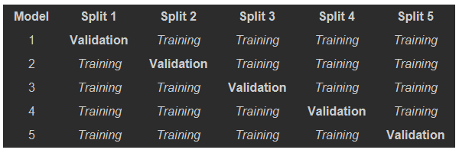
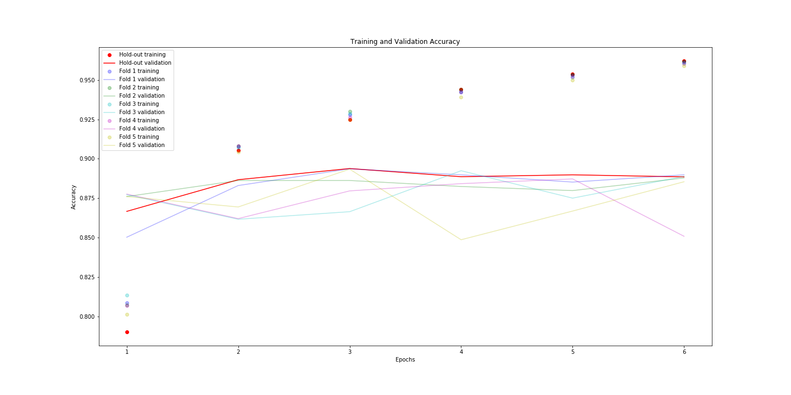
Tutorial Project – Classify Movie Reviews
Dataset of 50.000 positive & negative movie reviews (binary classification)
Simple network with 3 fully connected layers (16x16x1) is trained using hold-out and k-fold cross-validation (6 epochs)
Network Accuracy:
Hold-Out Model: 87,70%
K-Fold Model: 86,82%
Models perform similarly. However, k-fold cross-validation is more robust with small datasets

Slide 6
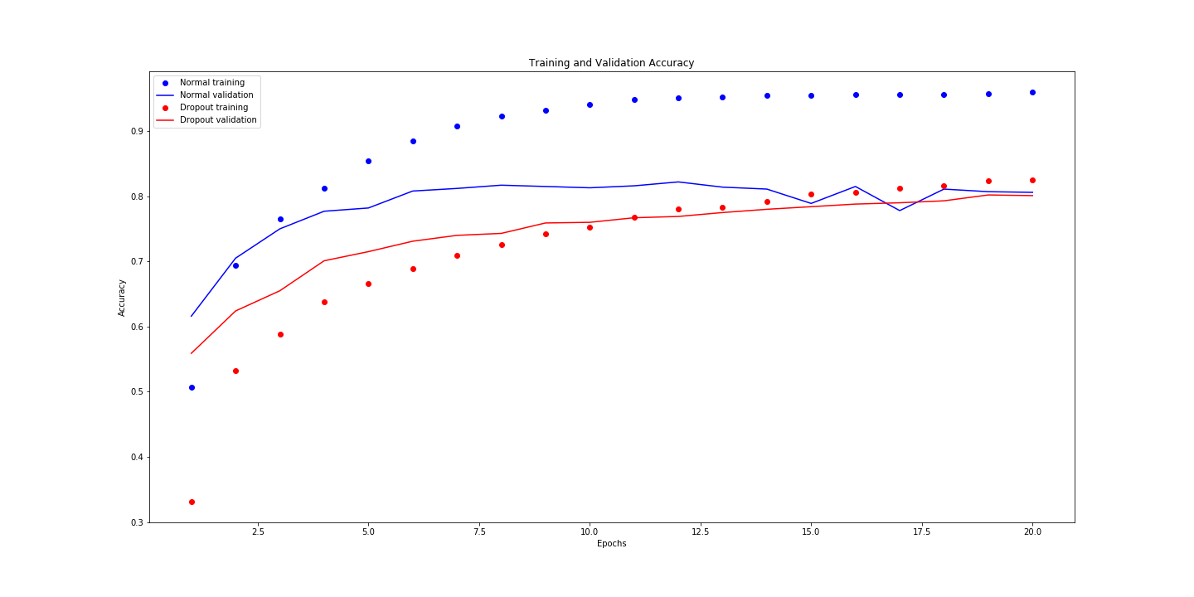
Tutorial Project – Classify Newswire Topics
Dataset of 11.228 newswire articles in 46 topics (multiclass classification)
Simple network with 3 fully connected layers (64x64x46) is trained with 50% dropout after each layer (20 epochs)
Network Accuracy:
No-Dropout Model: 77,91%
Dropout Model: 77,07%
Models perform similarly. However, the no-dropout model achieves peak performance faster, but is less resistant to overfitting

Slide 7
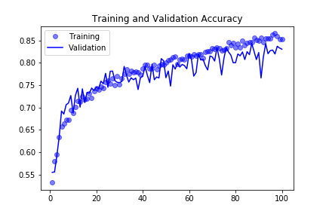
Tutorial Project – Classify Dog & Cat Images
Dataset of 4.000 images of dogs and cats (binary classification)
Simple Convolutional network with 4 convolutional layers and 2 fully connected layers is trained with pooling layers after each convolutional layer and 50% dropout after the fully connected layer (100 epochs)
Network Accuracy: 81%
Model performs adequate considering the heavily reduced dataset (originally 25.000 images). Dataset preprocessing and augmentation through random permutation very beneficial for limited datasets

Slide 8
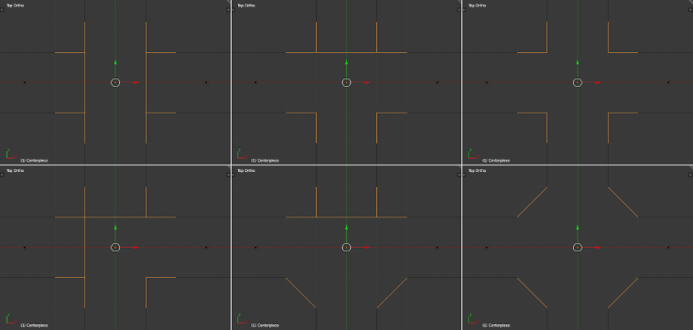
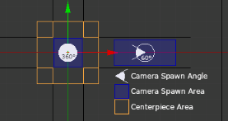
IntersectNet – CG Dataset
No datasets available. Lack of time and resources to record real data => render CG Dataset
Fixed layout with randomized centerpiece (random amount of connections rotated randomly)
Camera created at semi-random location and rotation
Layout textured with random textures

Slide 9
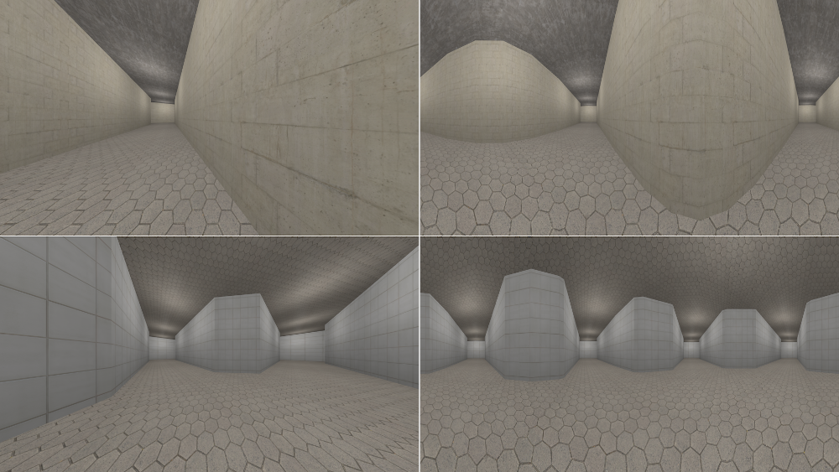
IntersectNet – CG Dataset

Slide 10
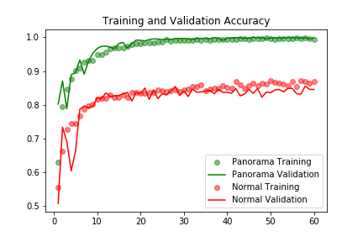
IntersectNet – Network Structure & Training
Dataset of 9.000 images of corridors and intersections (binary classification)
Simple Convolutional network with 4 convolutional layers and 2 fully connected layers is trained with pooling layers after each convolutional layer and 50% dropout after the fully connected layer (60 epochs)
Accuracy Results:
Normal Images: 84.2%
Spherical Images: 99.9%
The model trained with spherical images significantly outperforms the model trained with normal images.

Slide 11
IntersectNet – Results
Model also tested with real images (12 corridors, 12 intersections, 6 other locations)
Only predicts 14/24 correct (58%)
Over-prediction of intersections
Possible reasons:
Not enough variety/quality in dataset
Wide open spaces/corridors (trained with 2m wide corridors)
Bright light sources and reflections
Fix: Improve CG image variety/quality or retrain with real image dataset
Spherical imaging for autonomous navigation advantageous
Single sensor needed & no reliance on image sequences => faster detection/decision time
Notes:
6 other locations: Entrance hall (2), Outside (2), Stairway, Corridor w/ glass doors to both sides

Slide 12
Thank You For Your Attention!

